Slide 1

ORPHAN OR POOR FAMILY CHILDREN SYSTEM
ORPHAN OR POOR FAMILY CHILDREN SYSTEM
COURSE: CMSE322
GROUP 15
INTRODUCTOR: DUYGU ÇELIK ERTUĞRUL
LAB COORDINATOR: NADA KOLLAH
ZEYNEP PELIN ÇOLAK

Slide 2
Introduction
Outline
DB Diagram
Use Tools
Outline
Testing
Design
Conclusion

Slide 3
Introduction
Introduction
The aim of this project is to create a web application that leverages modern technology to support children in need and provide them with a better future. The application aims to bring together potential foster families or sponsors who support orphan or poor children and provide them with a healthy family environment.

Slide 4
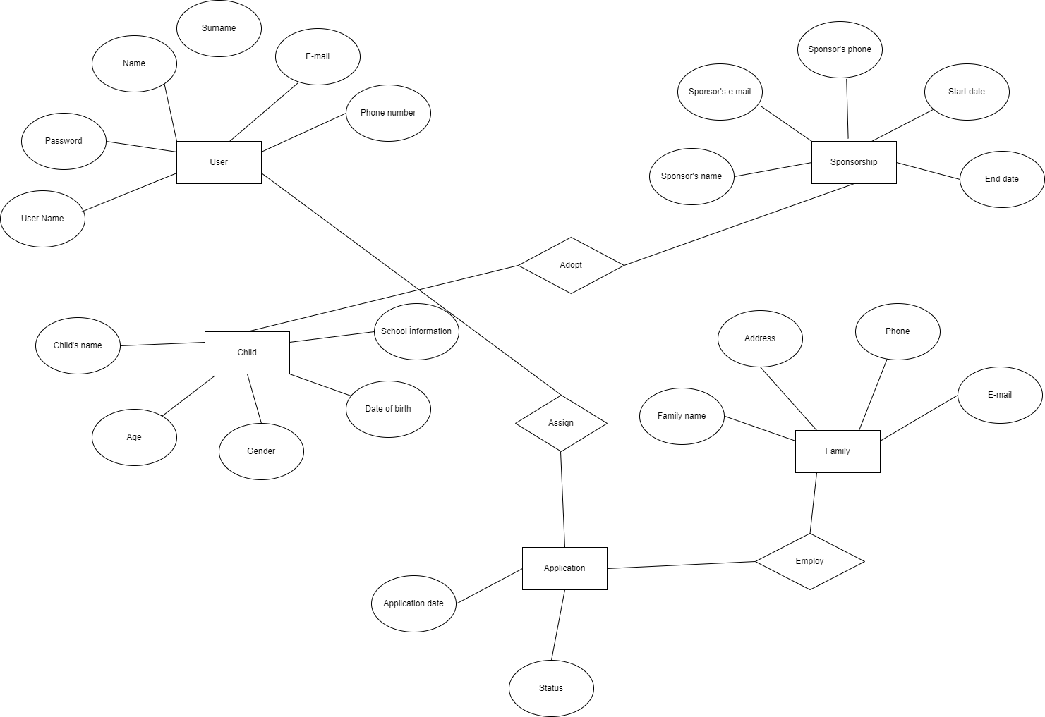
ER Diagram
Er Diagram

Slide 5
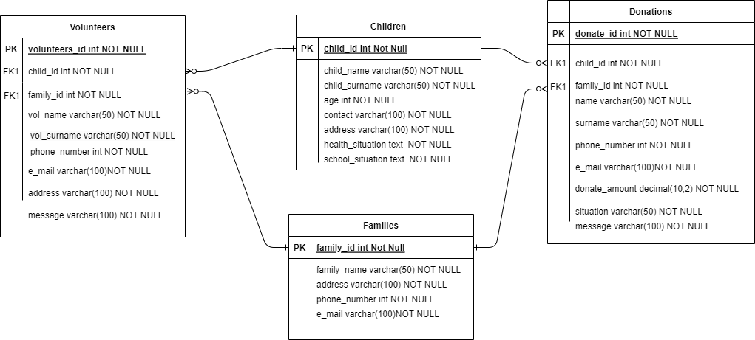
DataBase Table
Data Base Table
CREATE TABLE Children ( child_id INT PRIMARY KEY, child_name VARCHAR (50),child_surname varchar(50), age int NOT NULL,contact varchar(100),address varchar(100),health_situation text ,school_situation text,);
CREATE TABLE Families( family_id INT PRIMARY KEY,family_name VARCHAR (50),address varchar(100),phone_number int,e_mail varchar(100),);
CREATE TABLE Volunteers( volunteers_id INT PRIMARY KEY, child_id int Foreign Key, family_id int Foreign key, vol_name varchar(50),vol_surname varchar(50),phone_number int,e_mail varchar(100),address varchar(100),message varchar(100),);
CREATE TABLE Donations (donate_id int PRIMARY KEY , child_id int Foreign Key, family_id int Foreign key, name varchar(50), surname varchar(50),phone_number int,e_mail varchar(100), donate_amount decimal(10,2), situation varchar(50),message varchar(100),);

Slide 6
TOOLS
Tools
Various tools, technologies and platforms are used when creating a website. The basic programming language is PHP and its core functions are developed using this language. MySQL database is used to store data. The design of the website is created with HTML and CSS, and the themes are shaped using these languages. JavaScript is used for user interactions and special features. Tools like Bootstrap, which are popular CSS frameworks, can be used for rapid development and responsive design.

Slide 7
TESTING
Testing
Test -Case ID: | TC -01
Test –Case Name: | Donate Form
Pass/Fail Criteria: | System show display donate page and update database with the changes made by the user
Input Data: | Donate, First name, Last name, Phone number, E-mail, Donation amount, message
Test Proceduce | Test Results
Step 1:Click Donate | System shows “Donate” panel
Step 2:Edit Form | System saves database with new form
Test -Case ID: | TC -02
Test –Case Name: | Foster Family Request Form
Pass/Fail Criteria: | System show display child details page and update database with the changes made by the user
Input Data: | Child name,Parent First name, Parent Last name, Phone number, E-mail, Address, message
Test Proceduce | Test Results
Step 1:Click Details | System shows “Enter Details” panel
Step 2:Edit Form | System saves database with new form

Slide 8
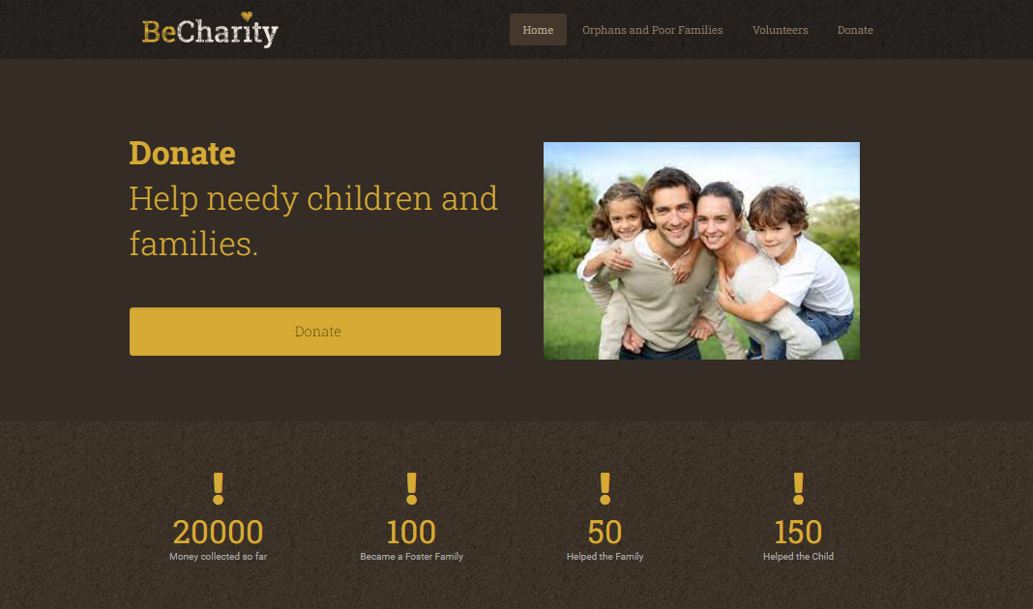
Home Page
Home Page

Slide 9
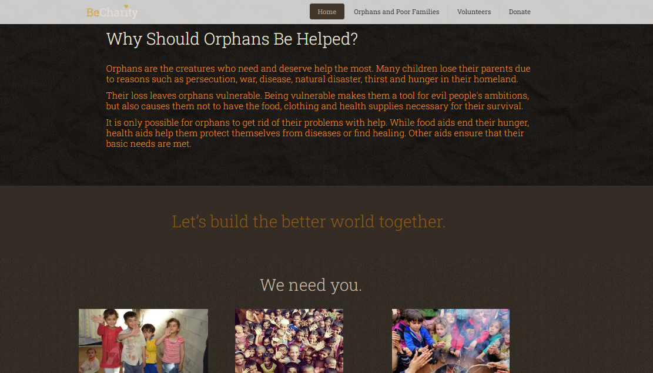
Home Page
Home Page

Slide 10
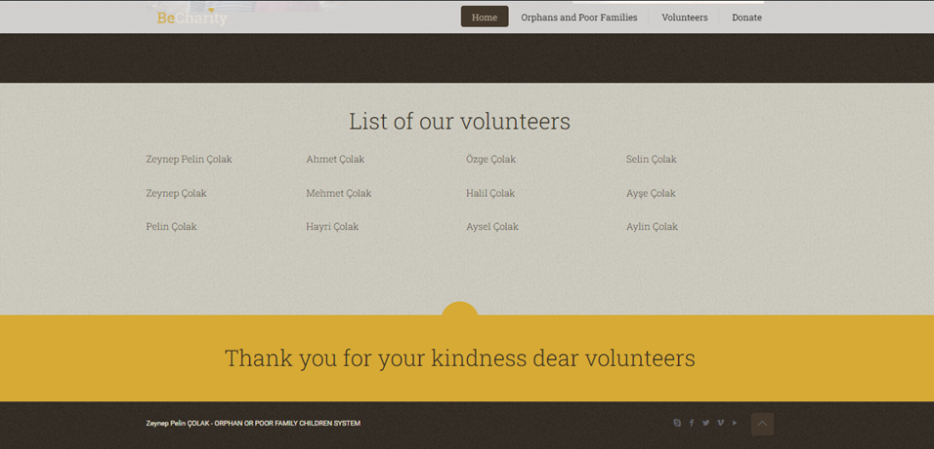
Home Page
Home Page

Slide 11
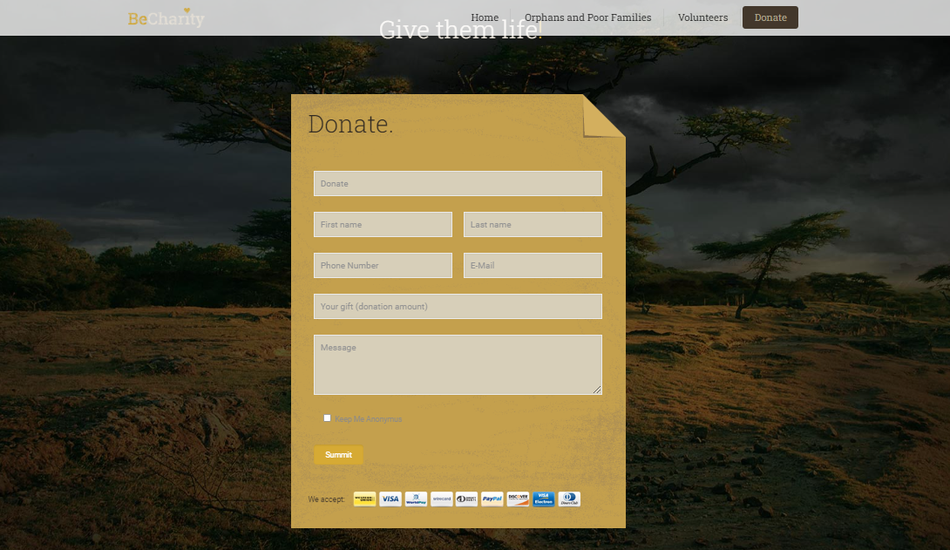
Donate
Donate

Slide 12
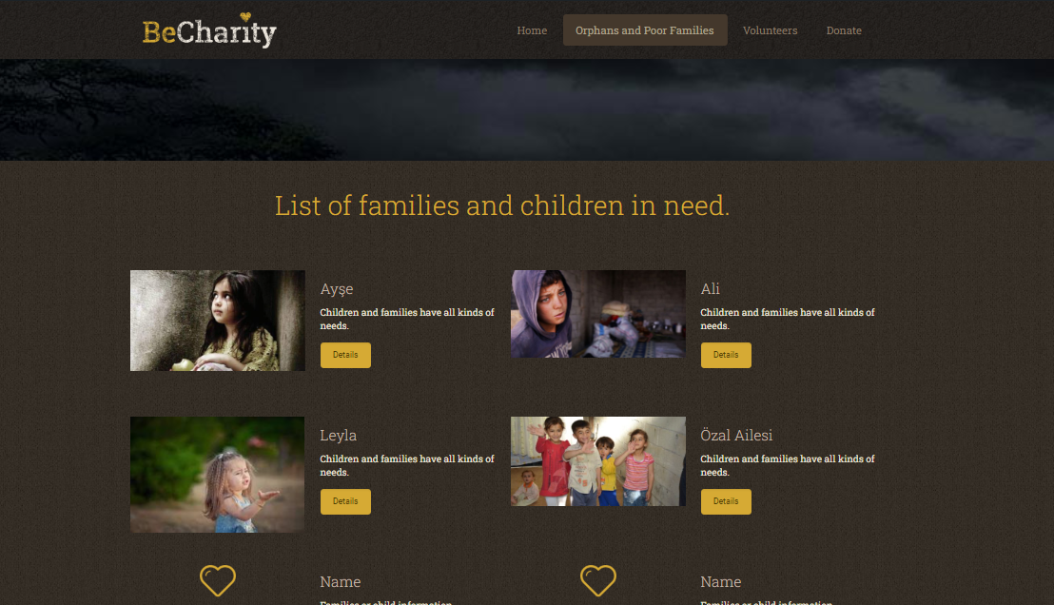
Orphans and Poor Families
Orphans and Poor Families

Slide 13
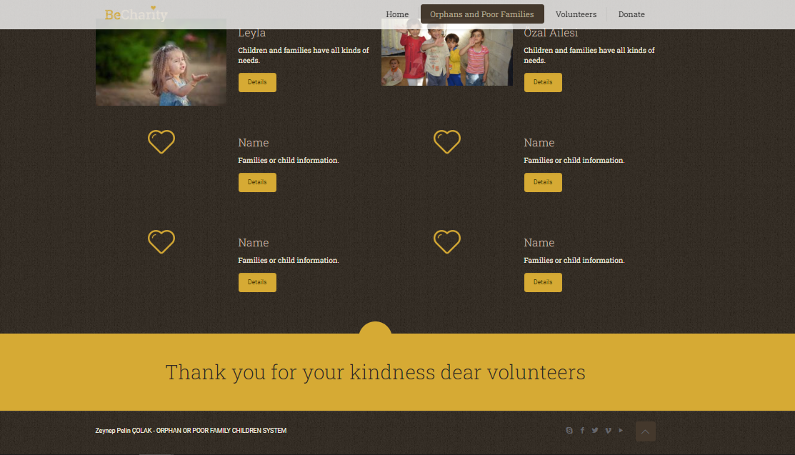
Orphans and Poor Families
Orphans and Poor Families

Slide 14
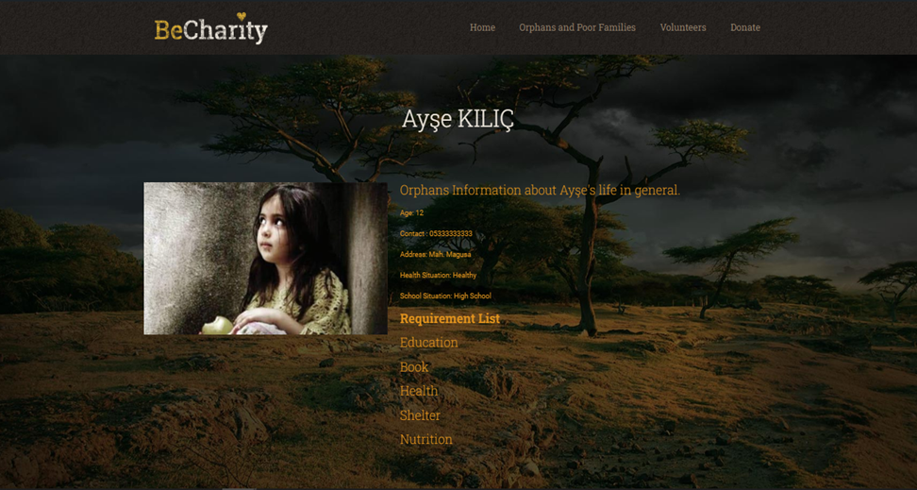
Child or Families Details
Child or Families Details

Slide 15
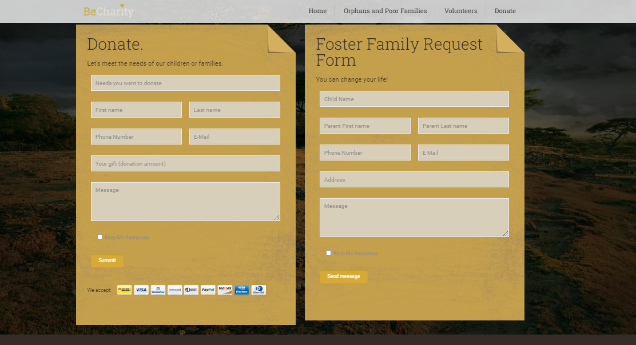
Child or Families Details
Child or Families Details

Slide 16
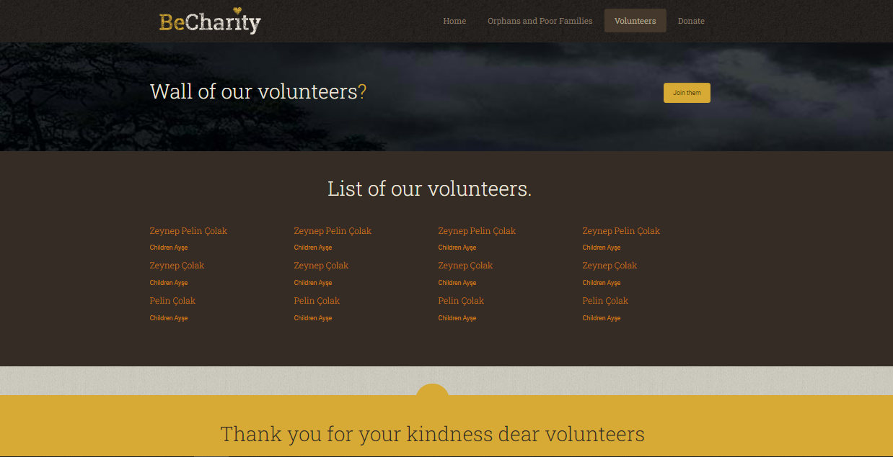
Volunteers
Volunteers

Slide 17
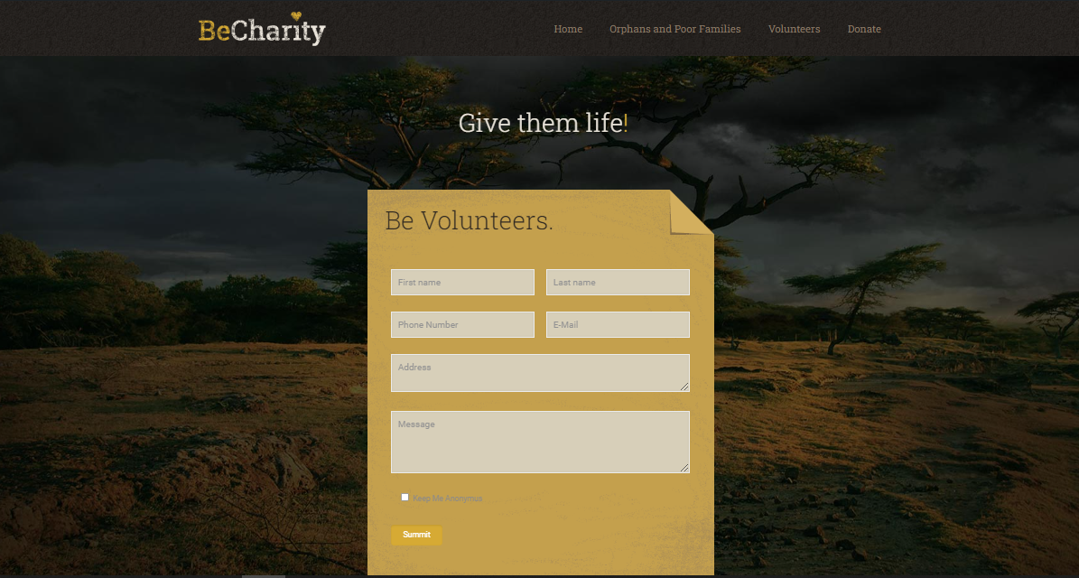
Join Volunteers
Join Volunteers

Slide 18
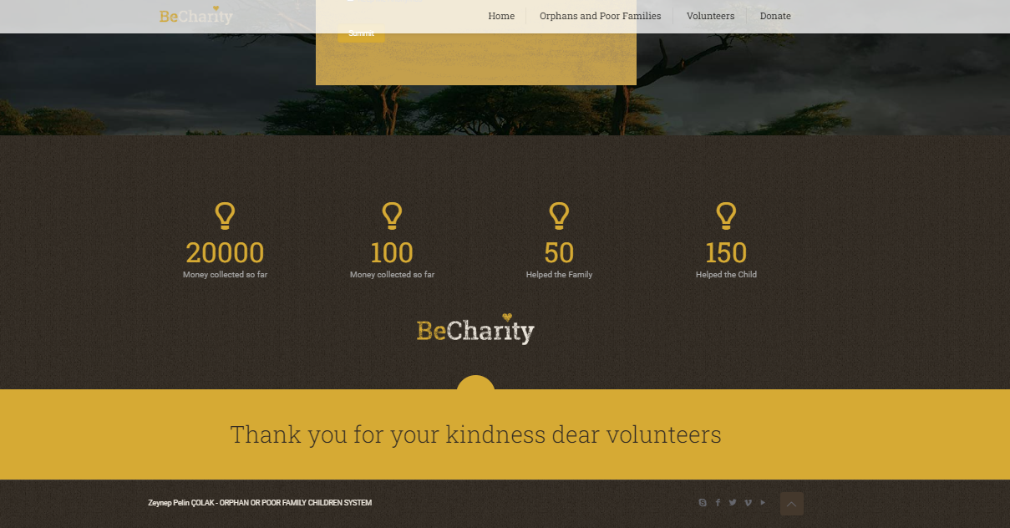
Join Volunteers
Join Volunteers

Slide 19
Conclusion
Conclusion
The impact of our solution is far-reaching. Economically, it provides financial support and resources to orphan or poor family children, offering them opportunities for education, healthcare, and overall better prospects for their future. By connecting them with foster families or sponsors, we empower both the children and the families, fostering economic growth and breaking the cycle of poverty.

Slide 20
Thamk You
Thank you
Listening & Watching

